Slide 1
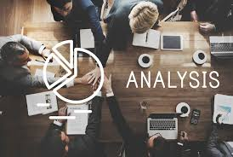
ASTROSAGE ANALYTICS
BY
Naveen H N
30/10/2024

Slide 2

Problem Statement
AstroSage has received a 1 crore investment and aims to optimize its call center operations. The goal is to determine how to allocate this investment to maximize operational efficiency, customer satisfaction, and profitability. The analysis will consider historical call data, performance metrics, and market trends to make informed decisions.

Slide 3

ABOUT ASTROSAGE
AstroSage is one of the most authentic astrology destinations for not only those who are seeking astrological assistance, but also for high-level astrological research and development on wide scale.
It is a prolific astrological source for people to help them out from mundane questions to specialized queries. Our aim is to ameliorate those who are facing problems and betterment of humanity using divine science of astrology.

Slide 4
HOW ASTROSAGE WORKS ?
1
2
3
4
5
User Registration And Login
New Users register on Astrosage platform for creating new IDs providing basic details like name, birthdate and preferred astrology services
Select desired service from Astrosage
Users must choose the desired services provided by Astrosage and choose according to the ratings and experience
Booking a consultation
After choosing an astrologer/guru users can book a consultation via call / chat at their desired time.
Expert Recommendations
During the consultation users have personalized experience with the astrologer and provided with recommendations to improve the quality of life
User Feedback and Detailed report
Post consultation users could provide a feedback regarding the consultation and could collect a detailed report of their consultation and could organize further consultations.

Slide 5

PROBLEM STATEMENT
The task is to optimize the call center operations for AstroSage, which has received a 1 crore investment. The goal is to determine how to allocate this investment to maximize operational efficiency, customer satisfaction, and profitability with relevant insights from the operational data. This project will involve analyzing historical call data, performance metrics, and market trends to make informed decisions.

Slide 6



ASTROSAGE DATA OVERVIEW
Dataset Overview
The dataset consists of 37 predefined columns. id, user, chatStatus, guru, guruName, gid, uid, consultationType, website, refundStatus, chatSeconds, queue, freeCall, freeChat, createdAT, updatedAt __v, statementEntryId, chatEndtTime, chatStartTime, callChannel, callIvrType, callStatus, CallSid, amount , astrologerCallStatus, astrologerOnCallDuration, astrologersEarnings, netAmount, region, userCallStatus, userOnCallDuration, rating
From those columns, 15 are categorical columns mentioned below: chatStatus, consultationType, website, refundStatus, isWhiteListUser, queue, freeCall, freeChat, callChannel, callIvrType, callStatus, astrologerCallStatus, region, userCallStatus, rating
Total number of rows of consultation is 28027
Total revenue of more than 200000 Rs. across all platforms and all categories.
Total Active agents of 131 ready for consultations.
Total customers of more than 10000 actively seeking consultations from Astrosage across all platforms.

Slide 7






DATA CLEANING & PREPROCESSING
Unwanted attributes from the dataset like TimeDuration, isWhitelistUser & Queue have been removed as they contain static data for every user.
CreatedAT attribute have been cleaned and formatted to datetime, columns added to extract month from CreatedAt for the data distribution analysis.
Removed unwanted characters from chatStartTime and chatEndTime to improve data consistency.
Removed extra spaces and duplicates values from guru name attribute in the cleaning process.
The cleaned data would be used for further analysis and would provide a time series performance of the organization.
The Data would provide key insights valuable for organizational decisions and contribute to the exponential growth of Astrosage.
Analysis would determine the purpose at which the investment of Rs 1 Crore would be used for Astrosage.

Slide 8






ANALYTICAL TOOLS AND APPROACH FOR ANALYSIS
Data Cleaning: Various functions & tools like Trim(), Proper(), Find & Replace, Left(), Right() & filter() have been used in cleaning the dataset
Data Enrichment: Enhanced the functionality of dataset by using functions like Xlookup() and Index() to search for various key performance variables.
Data Aggregation: Functions like AVERAGEIF(), MAX(), MIN(), SUMIF(), COUNTIF() have been used to derive specific metrics out of the data set.
Trend Analysis: Deployed various pivot tables and their respective time series charts to determine trendline of the performance.
Platform Segmentation: Categorized the platform used to identify the user activity in each of them
Visualization: Using dynamic charts and slicers data visualizations have been shown to derive meaningful inferences.

Slide 9
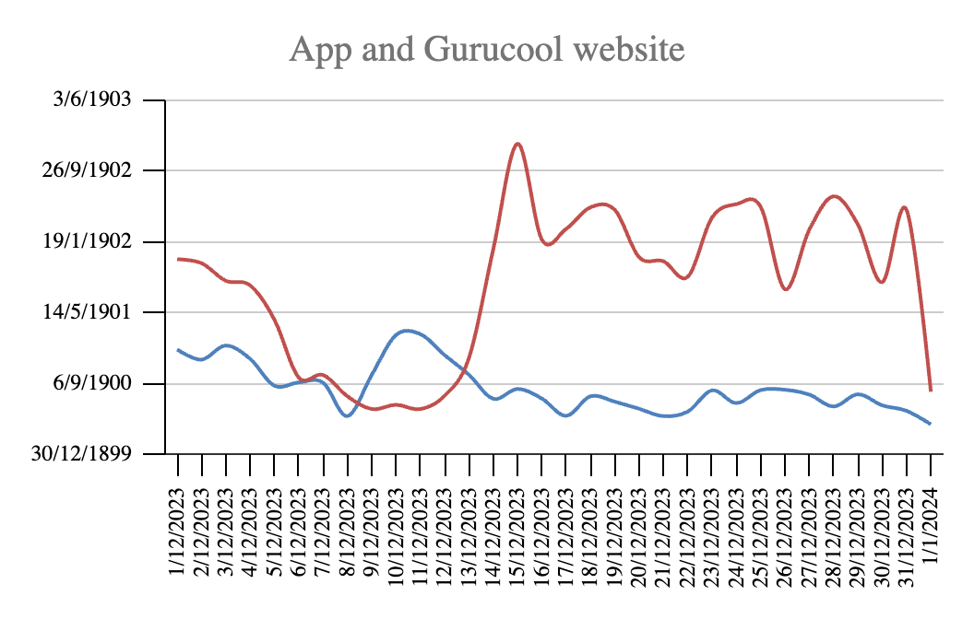
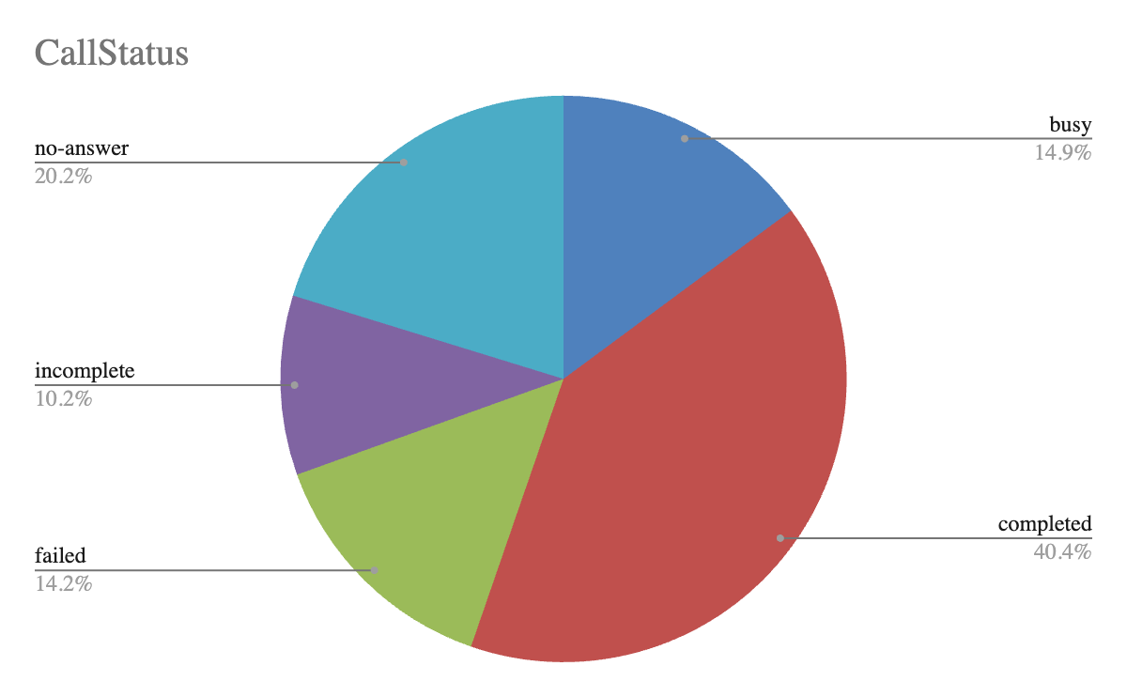
ANALYSIS ON DAILY CALL VOLUMES
Daily call volumes have been declining gradually which could be identified from the trendline.
Calls being the major contributor to revenue, declining in call volume exponentially affect the revenue.
One of the Major reason for this would be the percentage of failed/ incomplete calls which contributes to 58.74% of total call volumes.

Slide 10
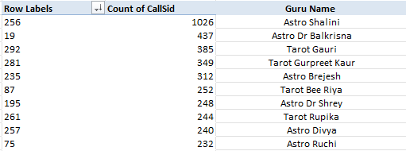
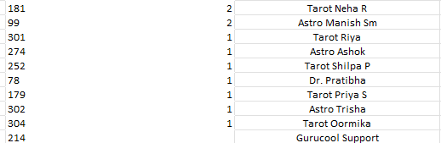

AVERAGE CALLS HANDLED BY AGENTS PER DAY
Top 10 gurus
The Top 10 agents by handling calls is being generated by this pivot table
The average calls handled by an agent in a day is 1.98. [Formula used: (Total No of calls)/(Total no of agents)*(Total number of days)]
The Top gurus have been overloaded with extreme number of calls and the bottom gurus have been handling very a smaller number of calls depicting poor call distribution.
Call distribution to be optimized by using better marketing techniques for better call facility to the customers.
Bottom 10 gurus

Slide 11
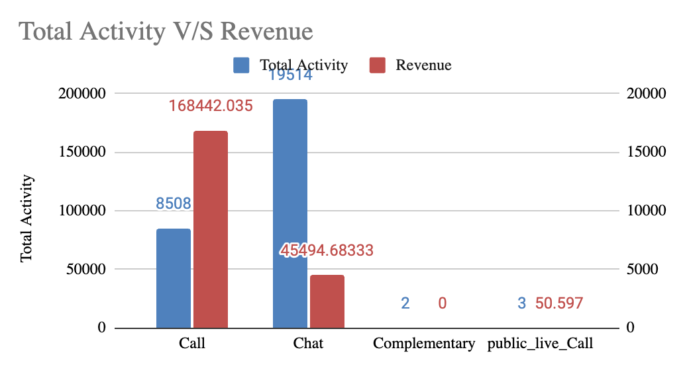
REVENUE GENERATED BY EACH CATEGORY
From the Column chart it is evident that the highest revenue is generated by calls, but the maximum activity recorded is from chats.
Revenue generated from chat is Rs. 45495 from 19514 consultations depicting users' preference over chat is more.
The free chat option provided to customers is very helpful in attracting user activity, but the resources (the gurus) are being utilized drastically.
An AI chatbot would solve the existing problem of resource allocation and would attract more customers.

Slide 12
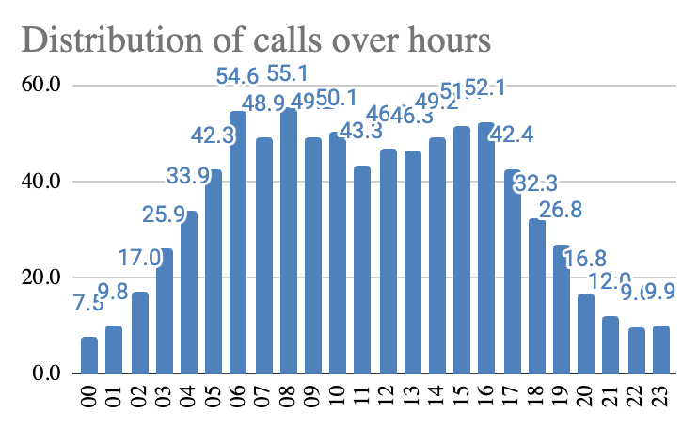
PEAK CALL HOURS & AGENT MANAGEMENT
The number of calls have been distributed over the time span of 24 hrs depicting the hourly call volumes.
Most of the calls have been performed between 5AM till 5PM considering the most productive time for business.
This time period consists of 79.92 % of total call volume
Shifts of the Agents should be optimized to make sure experienced agents would attend the calls at this time period increasing customer satisfaction.
To optimize the agent allocation a flexible working pattern should be followed to avoid agent burnout.

Slide 13
STRATEGIC RECOMMENDATIONS
Enhancing Customer Satisfaction through expertise agents
Recommended Actions:
Implement training programs focused on:
Communication Skills: Enhance clarity and professionalism during challenging interactions as customer satisfaction rate dropped in calls.
Problem-Solving: Equip agents with strategies to efficiently handle complex customer queries.
Technical Knowledge: Strengthen agents' ability to manage system operations and product-related issues.
Post-Training Assessment:
Track key performance indicators (KPIs) to evaluate the success of the training programs.
Risks & Impact Observed:
Change in Failure Rates: Monitor for reductions in agent failure rates post-training to assess performance improvements.
Customer Satisfaction Improvement: Analyze post-training customer satisfaction ratings to determine if there is an increase in positive feedback following the intervention.

Slide 14
STRATEGIC RECOMMENDATIONS
Optimizing Call Handling Operations
Recommended Actions:
Prediction of Peak Periods & Scheduling Adjustments Use real-time predictive analytics alongside historical data to dynamically adjust staffing during peak times, responding to emerging patterns such as holidays and promotions.
Shift Work for Stress Management Implement a flexible work-hour model tailored to agents' preferences and energy levels, reducing burnout and fostering better productivity through employee-centric scheduling and stress relief breaks.
Skill-Based Call Routing Introduce AI-powered dynamic skill routing to allocate calls based on real-time agent performance and skill updates, optimizing call handling efficiency and reducing resolution times.
Real-Time Monitoring & Workload Balancing Use automated workload distribution systems and performance dashboards to balance call assignments in real time, ensuring fair workload distribution and agent autonomy.
Customer Satisfaction Improvement: Analyze post-implementation customer satisfaction ratings to determine if there is an increase in positive feedback following the intervention.

Slide 15
STRATEGIC RECOMMENDATIONS
Implementing new technologies for overall business growth
Recommended Actions:
AI and Machine Learning implementation AI and ML technologies streamline call center operations by automating routine tasks and optimizing resource allocation. This reduces the workload on human agents, allowing them to focus on complex inquiries, improving both efficiency and customer satisfaction.
AI-Powered Chatbots to replace real agents NLP-based AI chatbots autonomously handle simple customer inquiries, lowering call traffic and boosting agent productivity. By mimicking human conversations, these chatbots provide personalized, fast solutions, freeing agents for more complex tasks.
Recommended Tools
IBM Watson: Advanced AI platform for managing diverse customer queries.
Google Dialogflow: Customizable, scalable NLP chatbot for seamless interactions.
Zendesk Answer Bot: Automates FAQs, reducing agent workload and improving response times.

Slide 16
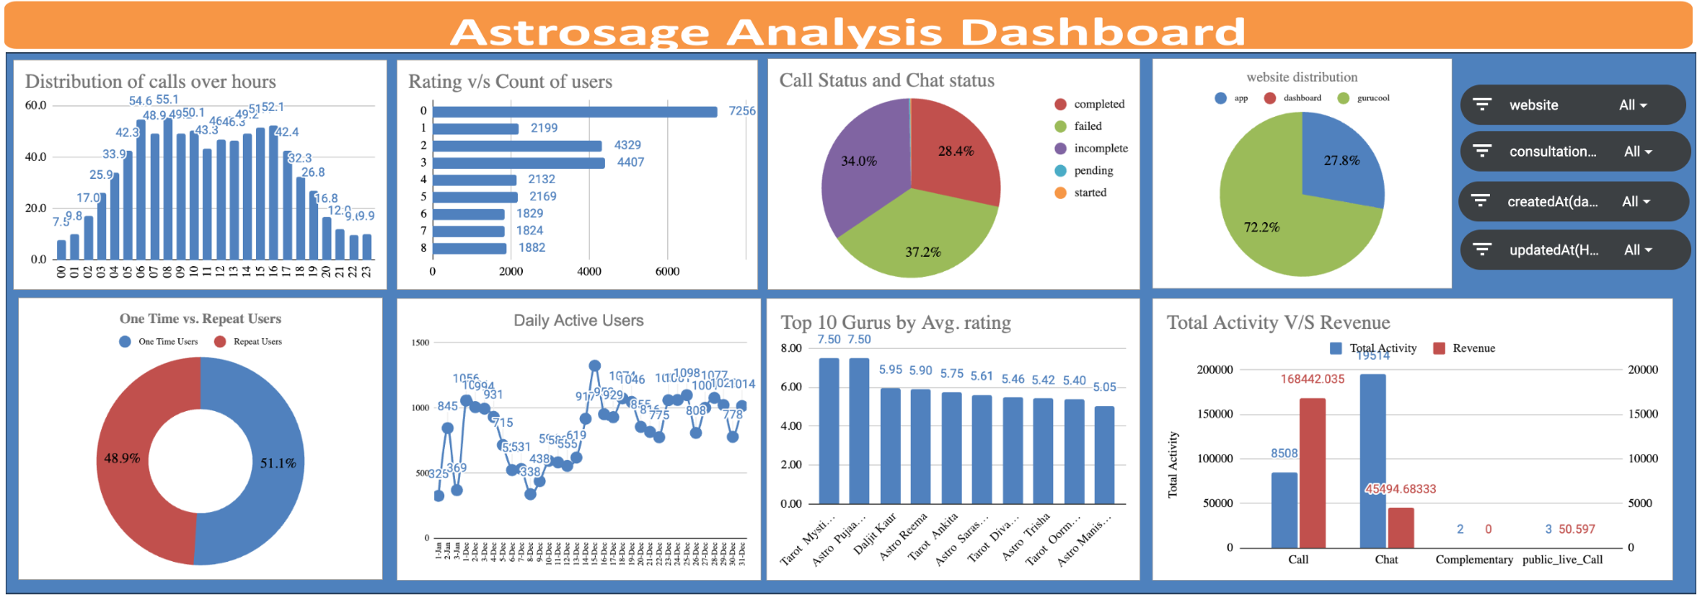
ANALYTICAL DASHBOARD
The Key metrics are present in the top 3 tiles
Supporting charts visualized to obtain a clear analytical overview
Slicers have been used to filter the data according to the management to have a closer look on the dataframe.

Slide 17

CONCLUSION
Key Findings:
Low Customer satisfaction: Despite having high call volumes and chat processes the customer rating still degrading due to low quality of consultations.
Low revenue through chat: Having highest traffic on chat the revenue is comparatively very low due to the free chat options and failed chat statuses.
Implications:
Revenue growth: Customer satisfaction improvement results in high retainability and gradually contributing to revenue growth.
Emergence as Business leader: With integration of AI chatbot operational cost will drastically go down as less resources would be required and ultimately keep the business ahead of its competitors.
Closing Statement: Astrosage being a new age astrology service show great potential in the business model and capability to capture bigger market in coming days with the implementation of the recommendations.

Slide 18





REFERENCES
AstroSage Report 2023
Data-cleaning methodologies - GeeksforGeeks.com, DataCamp.com
Image generation tool for slides - Powerpoint
Software used – MS Excel and MS Powerpoint

Slide 19

THANK YOU

